Slide 1

Business Process Engineering
FALL-2025

Slide 2
Today’s Agenda
Introductory Session
Course Objectives
Learning Outcomes
Administrative Items
Fundamental Concepts
Questions ?

Slide 3
Course Objectives
Help students to:
  understand the fundamental concepts of business process engineering (how they can be improved and streamlined for optimum efficiency in terms of performance.).
  learn the skills and knowledge required for:
    describing the lifecycle of a business process.
    modelling a business process
    Identifying business wastes
    mapping them into a business model.
  learn the methodologies of business process improvement
  understand how a business process could be re-engineered

Slide 4
Overall Learning Outcomes
Upon completion of this course, you will be able to understand and describe:
  the significance of business process engineering
  lifecycle of a business process
  various business process modelling techniques
  the concept of business wastes
  how a business process could be improved
  the process of business process re-engineering

Slide 5
Tentative Course Contents
Business Process – Basics, Origin, History and Evolution (Hierarchy of Business, Processes and BPE, The Difference between Functions and Processes)
Components of a Business Process
Business Process Management life cycle
Basics of a Manufacturing Process
Basics of a Service Process
Business Process Modelling Techniques
Business Process Improvement
Business Outsourcing
Business Process Re-engineering and improvement cases

Slide 6
Course Material
Lecture Slides
Handouts/Research Papers
Reference Material
  Business Intelligence: A Managerial Approach by E. Turban, R. Sharda, D. Delen and D. King, 2nd Edition, Prentice Hall.
  Business Process Improvement: The Breakthrough Strategy for Total Quality, Productivity, and Competitiveness, by H. J., Harrington, McGraw-Hill Education.

Slide 7
Plagiarism Policy
Any form of cheating in assignments, homework problems, quizzes, and exams will result in strict action.
Plagiarism detection tools might be used to determine who has cheated in assignments.
All the parties involved will be awarded Zero in the first instance.
Repeat of the same offense will result in (F) grade.

Slide 8
Tentative Grading Policy *
Class Participation 7%
Project (in phases) 8%
Quiz (8-10) 13%
Assignments (4-5) 12%
Mid Term 20%
Final 40%

Slide 9
Basic Concept
Bring direct value to customers and the company.

Slide 10
Basic Concept: Business Process
According to Gartner:
“An event-driven, end-to-end processing path that starts with a customer request and ends with a result for the customer.
Business processes often cross departmental and even organizational boundaries.”

Slide 11
Basic Concept: Workflow management
The goal of workflow management is to handle the flow of work efficiently so that right work is performed by right person at right time
Workflow is the automation of a business process, in whole or part, during which documents, information, or tasks are passed from one participant to another for action, according to a set of procedural rules

Slide 12
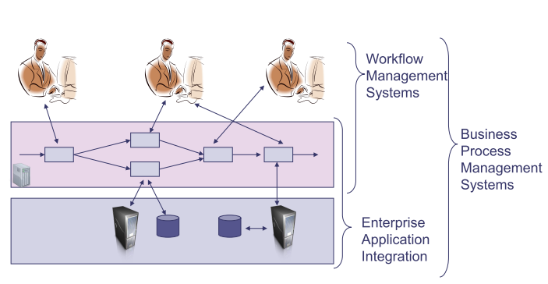
Basic Concept: WFMS, EAI, BPMS

Slide 13
A small case study: Double Check (DC)
Processing of insurance claims involving registration, two checks, and a payment of rejection
Five tasks:
  register (register insurance claim)
  checkA (check insurance policy)
  checkB (check damage reported)
  pay (pay for the damage)
  reject (inform customer about rejection)
Registration is followed by two checks which can be handled in parallel.
Each of the checks results in “OK” or “not OK”.
If both are OK, pay otherwise reject.
Three roles: register (for task register), checks (for both checks), and pay/reject (for final tasks).
checkA
pay
register
checkB
reject

Slide 14
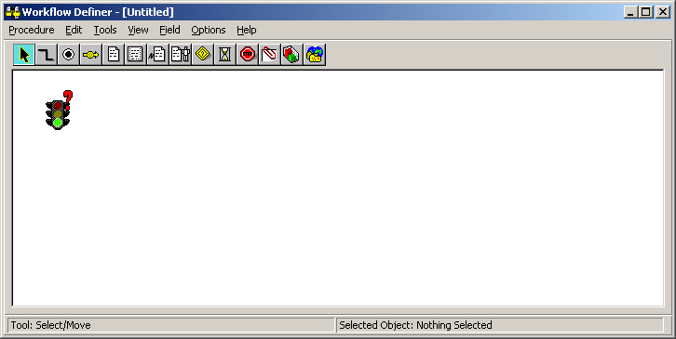
DC Example

Slide 15
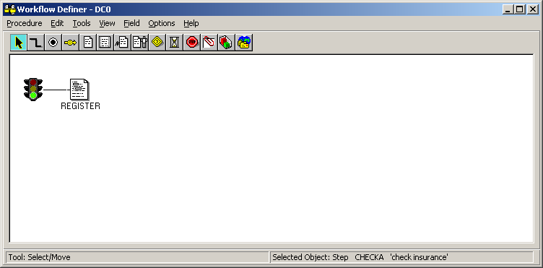
DC Example
Adding a step

Slide 16
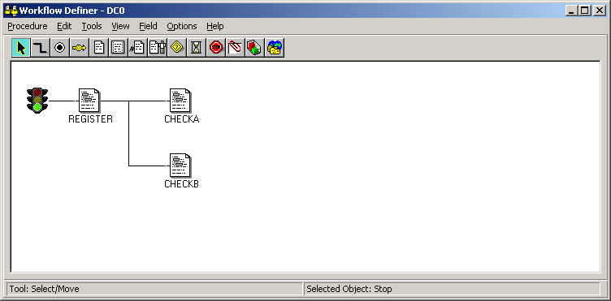
DC Example

Slide 17
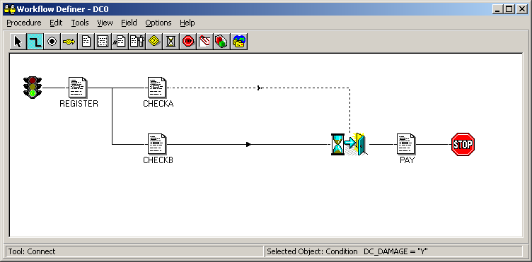
DC Example

Slide 18
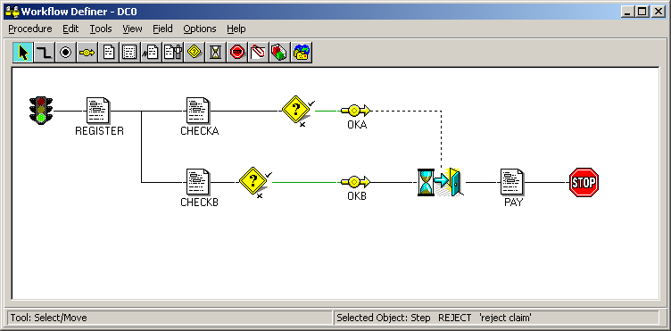
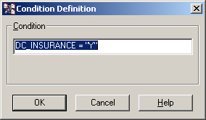
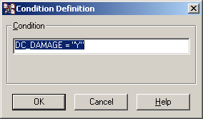
DC Example

Slide 19
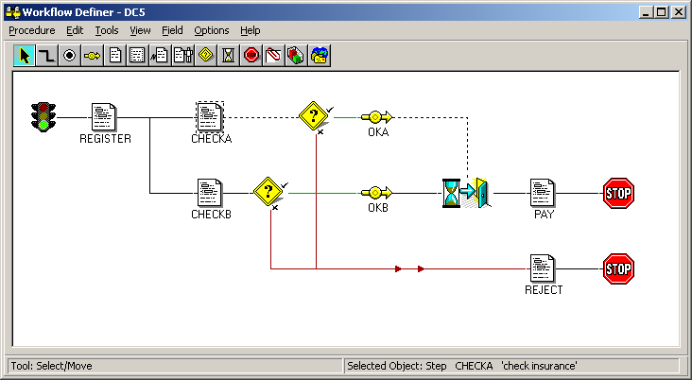
DC Example

Slide 20
The Birth of Process Thinking https://bprford.wordpress.com/2014/03/12/business-process-reengineering-fords-accounts-payable-case-study/

Slide 21
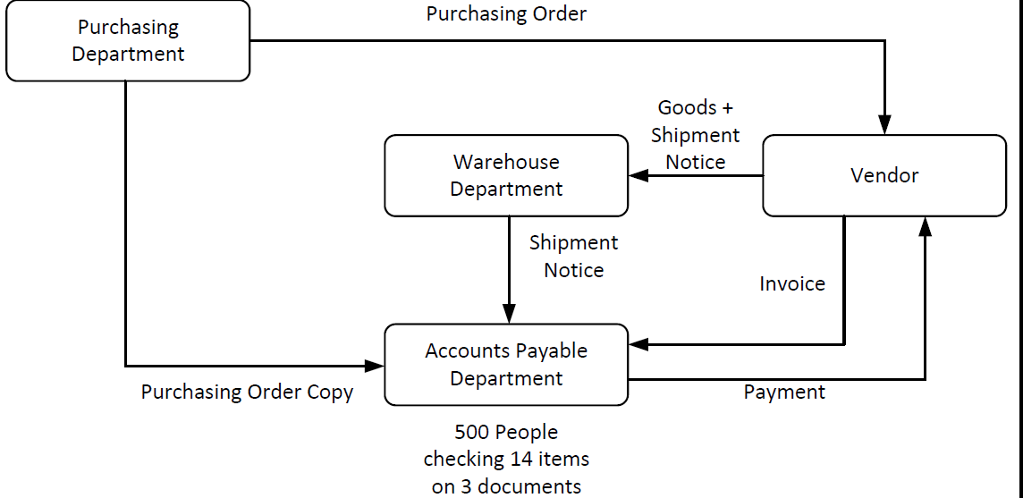
Purchasing process at Ford at the initial stage

Slide 22
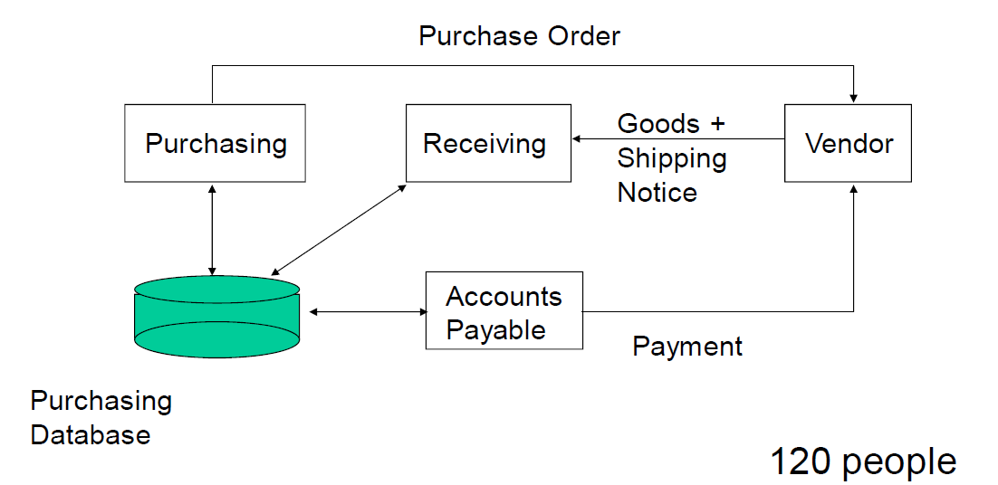
Purchasing process at Ford after redesign

Slide 23
Importance of Business Processes
Represent how processes are performed inside a company
Help to measure the performance of a business process
Help in hiring the right person for an efficient execution
Enhance coordination among various stakeholders
Improve a process by optimizing and/or automating using a software

Slide 24
Essential Attributes of a Business Process
Repeatability
  Everyday processes of a business
  Totally part of an organization, whether they are visible to customers or not
  Involve multiple defined inputs, which are affected by different factors, and contribute to the final output value
Flexibility
  Main processes are not changed or updated by businesses but still there is always room for improvement
  Every business process should be flexible without affecting its stakeholders

Slide 25
Essential Attributes of a Business Process
Specific
  Should be well-defined start point, end point and the series of these steps.
  Determine the individuals that perform in every step
  Should decide the reason why a process is automated
Measurable
  Should be measurable in every part to identify which part of the process works well or not
  Nothing can be better without measuring first
  Helps in identifying which processes have more benefits due to business process automation

Slide 26
Business Process Categorization
Every business is different with the types of business processes varying depending on the business nature.
A specific type of task could be a support process in one business and a core process in another.
The output of a process and its contribution towards the business determine the type of business process.

Slide 27
Types of Business Processes
Core Processes: How you deliver a value
  Directly serve external clients and generate income
  Also known as Primary Processes
  How does my business generate value and make its income?
  What does my business primarily do?
Examples of Core Processes
  Developing and creating a product or service
  Marketing the product or service and conveying it to the buyer
  After–sales service and support also add value and are part of core processes

Slide 28
If you are in a t-shirt company, one of your core operational processes is taking orders over the phone. Another would be getting manufactured t-shirts off to be shipped.
Whatever your business does at its core, there should be watertight processes in place to make your business scalable and efficient.

Slide 29
Types of Business Processes
Support Processes: Making Value Delivery Possible
  Serve internal clients and do not generate income in themselves
  Make it possible to carry out core processes effectively
Example
  HR activities have nothing to do with customers, and they don’t directly generate money, but without them the business couldn’t function
  IT department doesn’t directly generate money, but without the systems it oversees, the value-generation part couldn’t function

Slide 30
While these aren’t what the company does to make money, they facilitate the main revenue stream and make it so the management processes have something to manage, and that the operational processes are as friction-free as possible.

Slide 31
Types of Business Processes
Management Processes
  Optimize income generation
  Ensure the continued survival of the business as a whole
  Involve planning, coordination, monitoring and control of core and support processes
  Deal with opportunities and threats that could help or harm the business
  Ensure meeting:
    regulatory compliance needs
    Financial targets and budgets

Slide 32
An example of a management process might be a CEO planning out how best to organize the marketing team’s time and energy for a PR launch campaign. The process part would be allocating resources, defining timeframes and checking that the systems are in place and optimized

Slide 33
Examples of Business Processes
Order-to-cash
Quote-to-order
Procure-to-pay
Issue-to-resolution
Application-to-approval (document approval)

Slide 34
Business Process Engineering
Why do we need Business Process Engineering?
The field of business engineering developed primarily to fill the gap between the management and technical or administrative teams within a company.
Management may have difficulty translating their plans to technical teams, who may in turn find it challenging to develop products and solutions to carry out these plans in the real world.

Slide 35
Business Process Engineering
Business engineering acts as a bridge between these two areas, and is designed to help a company not only develop effective goals, but also techniques for carrying out these goals as efficiently as possible. This may require changes in every area of the company, from marketing to administration, to computer systems

Slide 36
Business Process Engineering
Unique aspect of BPE
Another unique aspect of the business engineering field is that it can be applied to a company at any stage of development.
Individuals who wish to form a new business can use these principles to select the best product or market, or to refine an existing idea.

Slide 37
Business Process Engineering
It can also be used to improve an existing business. This may mean increasing profit or cutting cost, but it can also refer to improving employee satisfaction or retention rates.
This process may involve making small changing or incorporating new technologies, or may require a complete redesign of the company and all its processes.

Slide 38
Business Process Engineering and software engineering
In many software engineering methods approaches to requirements engineering involve a detailed modeling of different aspects such as system structure data or behavior these models are an essential means of communication between system developers and expert users

Slide 39
Business Processes – Historical Perspective
Hundreds of years ago, work was the domain of each individual
  They completed all parts of the end-to-end process
  They researched, created, sold and distributed their products
Drawbacks
  Variations in the quality of produced/manufactured product
  Least productive
  Expensive
  Person dependent

Slide 40
Industrial Revolution (1760-1840)
Era of transition from the traditional hand based manufacturing to machines
New chemical manufacturing and iron production processes were introduced
Increased usage of steam power and water power for industrial processes
Development of machine tools gave rise to mechanized factory system
Business Processes need to be defined properly to represent the manufacturing and industrial processes

Slide 41
Scientific Management
In 1911, Frederick Winslow Taylor published “The Principles of Scientific Management” for the American Society of Mechanical Engineers
Taylor advocated “enforced standardization of methods, enforced adoption of the best implements and working conditions, and enforced cooperation” in order to improve efficiency
Taylor’s focus was on scientific study of work, standardization of process, systematic training and sound structure of employees and management.
The work was hugely unpopular with workers
Taylor’s work laid foundation for modern industrial engineering

